Slide 1
Predicting Climate Change for ClimateWins: Final Report
John Phillips
November 2024

Slide 2
Agenda
Objective
Machine Learning Options
Random Forests, Convolutional & Recurrent Neural Networks, Generative Adversarial Networks (GANs)
Thought experiments
Detecting and classifying anomalous weather events
Assessing trends in these anomalous weather events
Predicting safe areas based on climate trends
Social and Ethical Considerations
Recommendation and Next Steps

Slide 3
Objective
Use machine learning to explore the feasibility of different climate change questions:
Identifying anomalous weather patterns in Europe.
Determining if those patterns are increasing in frequency.
Generating possibilities for future weather conditions over the next 5-10 years.
Determining the safest places for people to live in Europe over the next 5-10 years.

Slide 4
Machine Learning Overview
Random Forests, Convolutional (CNNs) & Recurrent Neural Networks (RNNs), Generative Adversarial Networks (GANs)

Slide 5
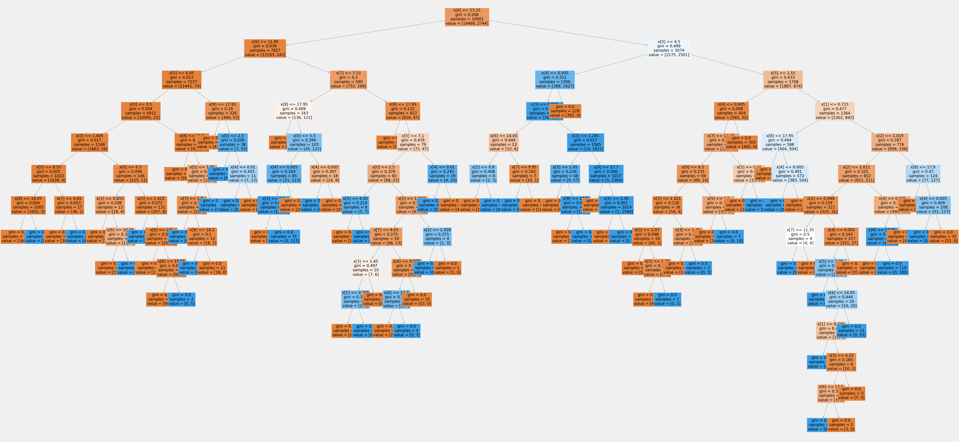
Random Forests
RFs are collections of decision trees that are effective at telling us which variables are most important in rare weather events.
Progress so far: RFs have told me that max temperature, average temperature, and precipitation are the top 3 variables for predicting daily weather conditions.
This will help us when detecting rare weather events.
A decision tree for the Kassel weather station.

Slide 6
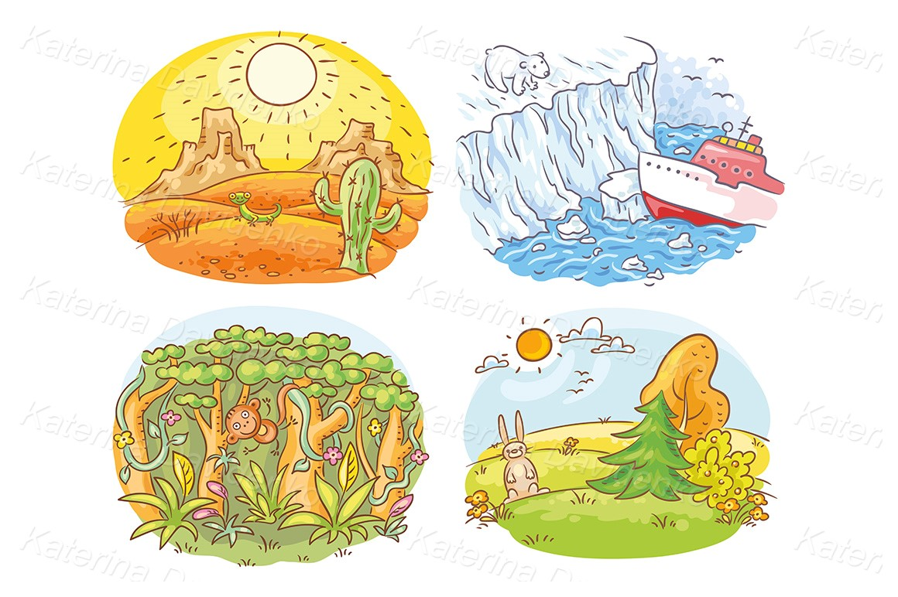
Convolutional & Recurrent Neural Networks
Deep learning models that excel at detecting spatial anomalies (CNNs) and overall climate trends (RNNs).
Progress so far:
I have trained both CNN and RNN models to correctly classify pleasant or unpleasant weather days across all stations 72% and 73% of the time, respectively.

Slide 7

Generative Adversarial Networks (GANs)
Consist of a generator and discriminator network that are useful in generating synthetic climate scenarios- including anomalous weather events.
Progress so far:
GAN accuracy for classifying four different weather conditions based off real images:
Sunrise- 98%
Shine- 98%
Rain- 98%
Cloudy- 39%

Slide 8
Three Thought Experiments
Which climate question is the most feasible for us to address?

Slide 9

TE 1 task: Detecting and classifying anomalous weather events
Approach: Utilize random forests to detect important anomaly variables and use CNNs to understand visual patterns associated with these events.
Data Bias: Regional underrepresentation for satellite imagery or data collection for financial or other circumstantial reasons.
Findings: my decision tree model is able to correctly classify weather conditions across all weather stations 93% of the time.

Slide 10
TE 2 task: Assessing trends in anomalous weather events
Approach: Implement RNNs to analyze trends over time; use random forests to detect important variables for these events.
Data Bias: Climate risk evaluations could be affected by regions who are underrepresented in the dataset.
Findings: The RNN model was 95% accurate and above for landlocked cities (such as Basel, Belgrade, Madrid) and struggled with coastal cities (like Oslo or Stockholm).
More work needs to be done to improve model capability across diverse environments.

Slide 11

TE 3 task: Identifying safe areas to live based on climate trends over the next 5-10 years
Approach: Use random forests to establish risky environmental features, then have GANs generate potential future scenarios for European regions.
Data Bias: GANs could perpetuate biases inherent in historical data.
Findings: my current GAN model can correctly classify weather conditions 82% of the time, however we need more progress and training before we can predict years into the future.

Slide 12

Social and Ethical Considerations
Responsible communication: we must be transparent in our communication and ensure all relevant areas/regions are notified of our findings.
Financial incentives: the information generated could be mishandled for financial gain.

Slide 13
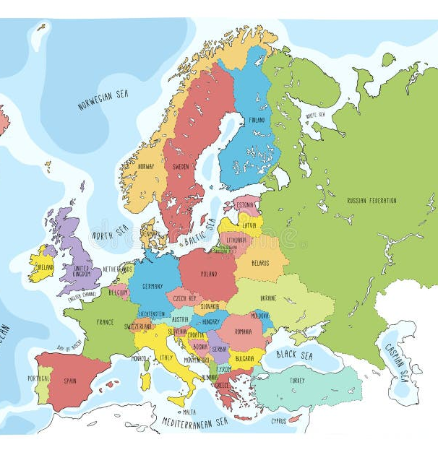
Recommendation and Next Steps
I recommend we start with the first option (detecting rare weather events), which is the easiest for us to solve now, and would naturally lead into the second option (how are they behaving).
The bottom line: I believe pursuing the first two options will be the least financially risky and the least time-consuming, allowing us to generate profitable, actionable information.

Slide 14
Thank you!
I will now take any questions.
For all info on this project please refer to GitHub.

